Slide 1



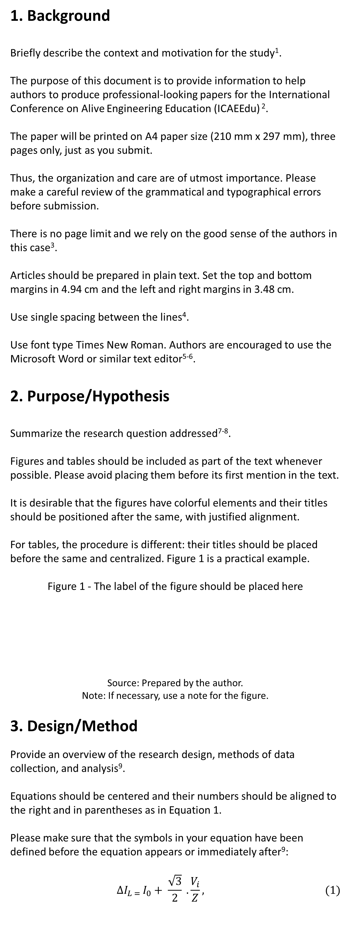
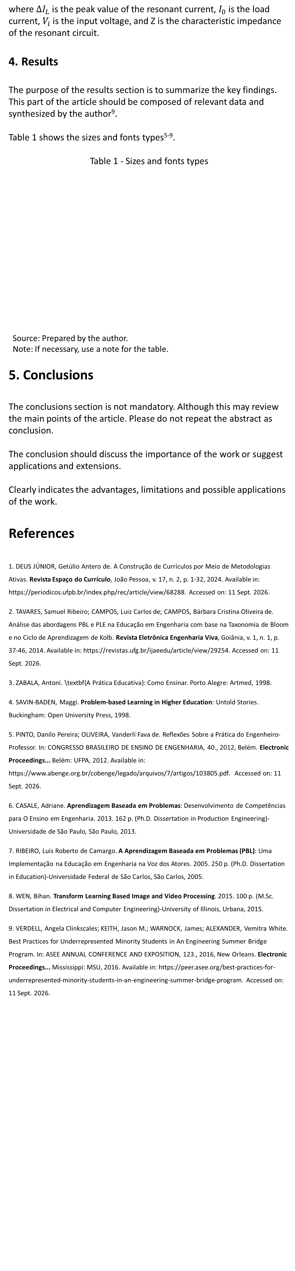
Paper Title
Subtitle as needed
First Author’s Name¹
Second Author’s Name²
Third Author’s Name³
¹E-mail address of the first author, ²E-mail address of the second author, ³E-mail address of the third author, Department name of the first organization, City/Country
Fourth Author’s Name⁴
Fifth Author’s Name⁵
⁴E-mail address of the fourth author, ⁵E-mail address of the fifth author, Department name of the second organization, City/Country
Abstract
Abstracts should be 300-500 words properly formatted. It is recommended for abstracts the following structure: a Background to briefly describe the context and motivation for the study; a Purpose/Hypothesis to summarize the research question addressed; a Design/Method to provide an overview of the research design, methods of data collection, and analysis; Results to summarize the key findings; and Conclusions to state the key conclusion(s) based on the findings. This document contains information on the preparation of the final version of a paper accepted for publication in the International Conference on Alive Engineering Education. Please carefully follow the instructions provided to ensure legibility and uniformity of accepted papers.
Keywords: About five keywords of phrases in alphabetical order, separated by commas.
where $∆I_{L}$ is the peak value of the resonant current, $I_{0}$ is the load current, $V_{i}$is the input voltage, and Z is the characteristic impedance of the resonant circuit.
4. Results
The purpose of the results section is to summarize the key findings. This part of the article should be composed of relevant data and synthesized by the author⁹.
Table 1 shows the sizes and fonts types⁵⁻⁹.
Table 1 - Sizes and fonts types
Source: Prepared by the author.
Note: If necessary, use a note for the table.
5. Conclusions
The conclusions section is not mandatory. Although this may review the main points of the article. Please do not repeat the abstract as conclusion.
The conclusion should discuss the importance of the work or suggest applications and extensions.
Clearly indicates the advantages, limitations and possible applications of the work.
References
1. DEUS JÚNIOR, Getúlio Antero de. A Construção de Currículos por Meio de Metodologias Ativas. Revista Espaço do Currículo, João Pessoa, v. 17, n. 2, p. 1-32, 2024. Available in: https://periodicos.ufpb.br/index.php/rec/article/view/68288. Accessed on: 11 Sept. 2026.
2. TAVARES, Samuel Ribeiro; CAMPOS, Luiz Carlos de; CAMPOS, Bárbara Cristina Oliveira de. Análise das abordagens PBL e PLE na Educação em Engenharia com base na Taxonomia de Bloom e no Ciclo de Aprendizagem de Kolb. Revista Eletrônica Engenharia Viva, Goiânia, v. 1, n. 1, p. 37-46, 2014. Available in: https://revistas.ufg.br/ijaeedu/article/view/29254. Accessed on: 11 Sept. 2026.
3. ZABALA, Antoni. \textbf{A Prática Educativa}: Como Ensinar. Porto Alegre: Artmed, 1998.
4. SAVIN-BADEN, Maggi. Problem-based Learning in Higher Education: Untold Stories. Buckingham: Open University Press, 1998.
5. PINTO, Danilo Pereira; OLIVEIRA, Vanderlí Fava de. Reflexões Sobre a Prática do Engenheiro-Professor. In: CONGRESSO BRASILEIRO DE ENSINO DE ENGENHARIA, 40., 2012, Belém. Electronic Proceedings... Belém: UFPA, 2012. Available in: https://www.abenge.org.br/cobenge/legado/arquivos/7/artigos/103805.pdf. Accessed on: 11 Sept. 2026.
6. CASALE, Adriane. Aprendizagem Baseada em Problemas: Desenvolvimento de Competências para O Ensino em Engenharia. 2013. 162 p. (Ph.D. Dissertation in Production Engineering)-Universidade de São Paulo, São Paulo, 2013.
7. RIBEIRO, Luis Roberto de Camargo. A Aprendizagem Baseada em Problemas (PBL): Uma Implementação na Educação em Engenharia na Voz dos Atores. 2005. 250 p. (Ph.D. Dissertation in Education)-Universidade Federal de São Carlos, São Carlos, 2005.
8. WEN, Bihan. Transform Learning Based Image and Video Processing. 2015. 100 p. (M.Sc. Dissertation in Electrical and Computer Engineering)-University of Illinois, Urbana, 2015.
9. VERDELL, Angela Clinkscales; KEITH, Jason M.; WARNOCK, James; ALEXANDER, Vemitra White. Best Practices for Underrepresented Minority Students in An Engineering Summer Bridge Program. In: ASEE ANNUAL CONFERENCE AND EXPOSITION, 123., 2016, New Orleans. Electronic Proceedings... Mississippi: MSU, 2016. Available in: https://peer.asee.org/best-practices-for-underrepresented-minority-students-in-an-engineering-summer-bridge-program. Accessed on: 11 Sept. 2026.
Text | Size | Style
Title | 24 pt | Normal
Subtitle as needed | 18 pt | Normal
Author’s Name, Affiliation and Main Text | 9.5 pt | Normal
Title of the Sections | 14 pt | Bold
Titles of the Subsections | 12 pt | Bold
Title of the Abstract and Abstract | 9.5 pt | Bold
Figure’s Label, Table’s Label and Table Text | 9 pt | Normal
References | 8.5 pt | Normal
1. Background
Briefly describe the context and motivation for the study¹.
The purpose of this document is to provide information to help authors to produce professional-looking papers for the International Conference on Alive Engineering Education (ICAEEdu) ².
The paper will be printed on A4 paper size (210 mm x 297 mm), three pages only, just as you submit.
Thus, the organization and care are of utmost importance. Please make a careful review of the grammatical and typographical errors before submission.
There is no page limit and we rely on the good sense of the authors in this case³.
Articles should be prepared in plain text. Set the top and bottom margins in 4.94 cm and the left and right margins in 3.48 cm.
Use single spacing between the lines⁴.
Use font type Times New Roman. Authors are encouraged to use the Microsoft Word or similar text editor⁵⁻⁶.
2. Purpose/Hypothesis
Summarize the research question addressed⁷⁻⁸.
Figures and tables should be included as part of the text whenever possible. Please avoid placing them before its first mention in the text.
It is desirable that the figures have colorful elements and their titles should be positioned after the same, with justified alignment.
For tables, the procedure is different: their titles should be placed before the same and centralized. Figure 1 is a practical example.
Figure 1 - The label of the figure should be placed here
Source: Prepared by the author.
Note: If necessary, use a note for the figure.
3. Design/Method
Provide an overview of the research design, methods of data collection, and analysis⁹.
Equations should be centered and their numbers should be aligned to the right and in parentheses as in Equation 1.
Please make sure that the symbols in your equation have been defined before the equation appears or immediately after⁹:
$$∆I_{L = }I_{0}+ \frac{\sqrt{3}}{2} . \frac{V_{i}}{Z}, (1)$$
24-25 September 2026 | 4th Edition | Goiânia, Brazil

